Slide 1
TED Talks and NAWL Vocabulary Study Using CALL
Bob Ashcroft
Tokai University
Sapporo
Paul Raine
Keio University
Tokyo
JALT 2017
Sunday, 19th November 2017
Tsukuba
Notes:
Who uses technology in their classes?
Who uses technology to teach vocabulary?
How do we know if this technology is more effective than traditional methods?
How do we know which apps are the most effective?
How do we know which technology to embrace, and which to leave well alone?
In order to try to clarify such questions, today we want to tell you about an experiment which was conducted earlier this year, at 4 different universities in Japan, on 138 students.

Slide 2
Background
Research Questions
Method
Results
Questions?
Notes:
Main points:
Background
Research Question
Method
Results
Questions

Slide 3
Background
Research Questions
Method
Results
Questions?

Slide 4
Background
Notes:
Background
CALL impact
Ts try to embrace
Rapid advance
Research & pedagogy lag
Wow factor appeal
Is it really more effective?
This research compares 3 different computer based language learning apps in an effort to understand differences in effectiveness.

Slide 5
Background
Research Questions
Method
Results
Questions?
Notes:
xx

Slide 6
Background
Research Questions
Method
Results
Questions?
Notes:
xx

Slide 7
How do 3 computer-based vocabulary learning apps differ in terms of learning effectiveness?
Notes:
How do 3 different computer based vocabulary learning apps differ in terms of learning effectiveness?
One of the apps uses KWIC, with context from the TED
Does this contextual clue from the TED make a difference?

Slide 8
Background
Research Questions
Method
Results
Questions?

Slide 9
Background
Research Questions
Method
Results
Questions?
Notes:
xx

Slide 10
Target Vocabulary
Notes:
Corpus - academic journals and non-fiction, student essays, and academic discourse
963 words
academic corpus containing 288 million words
Charlie Brown – Meiji Gakuen University Tokyo

Slide 11
Context – TED Talks
NAWL 20+
6-12 minutes
Flesch-Kincaid Readability Ease (FKRE)
WPM
Interest
Accent
Gender
Notes:
Context - TED Talks
Analysed a corpus of all the TTalks
Selected 4 Video using above criteria (In this order)
FKRE – word length and sentence length

Slide 12
Particpants
Notes:
61 female
77 male
138 in total
4 unis in japan
Various academic backgrounds
All had a t lest one English class per week at the time of the study

Slide 13
Level | TOEIC | n
Beginner | 1-250 | 5
Pre-Intermediate | 255-400 | 23
Intermediate | 405-600 | 40
Upper-Intermediate | 605-780 | 45
Advanced | 785-900 | 23
Native | 905-990 | 2
Total: |  | 138
Notes:
Self reported scores

Slide 14
Procedure
Notes:
PAUL:
Procedure
1 x 90 minute session per week
x 5 weeks
Collects bio data
Everything saved on Survey Monkey
Session order is randomized - both app and video order
Everything on research portal
Collected data May ~ July 2017

Slide 15
Dependent Measures
TARGET | Prompt | correct response | distractor 1 | distractor 2 | distractor 3
residual | The word closest in meaning to residual is: | 残りの | その他の | たくさんの | 人工的な
Notes:
PAUL
Pre-post Tests
L2 Prompt - L1 Paired associate recognition
The only way coz computerized
Distractor 1 and 2 were similar but fundamentally different word meanings – as chosen by native 2 Japanese speakers
Distractor 3 was one of the other answers from the test taken at random

Slide 16
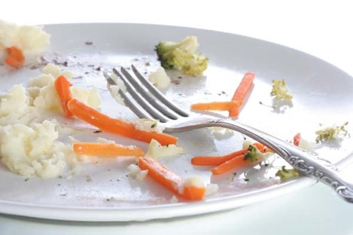
KWIC
IMAGE
L2
CONTROL
After the noise of the vocal chords are removed, only the ___________ sound is left.
Remaining after the greater part or quantity has gone.
Dummy treatment – different target vocabulary
reconstruct
residual
organ
compromise
reconstruct
residual
organ
compromise
reconstruct
residual
organ
compromise
resemble
assume
compact
conduction
Notes:
PAUL

Slide 17
Notes:
PAUL

Slide 18
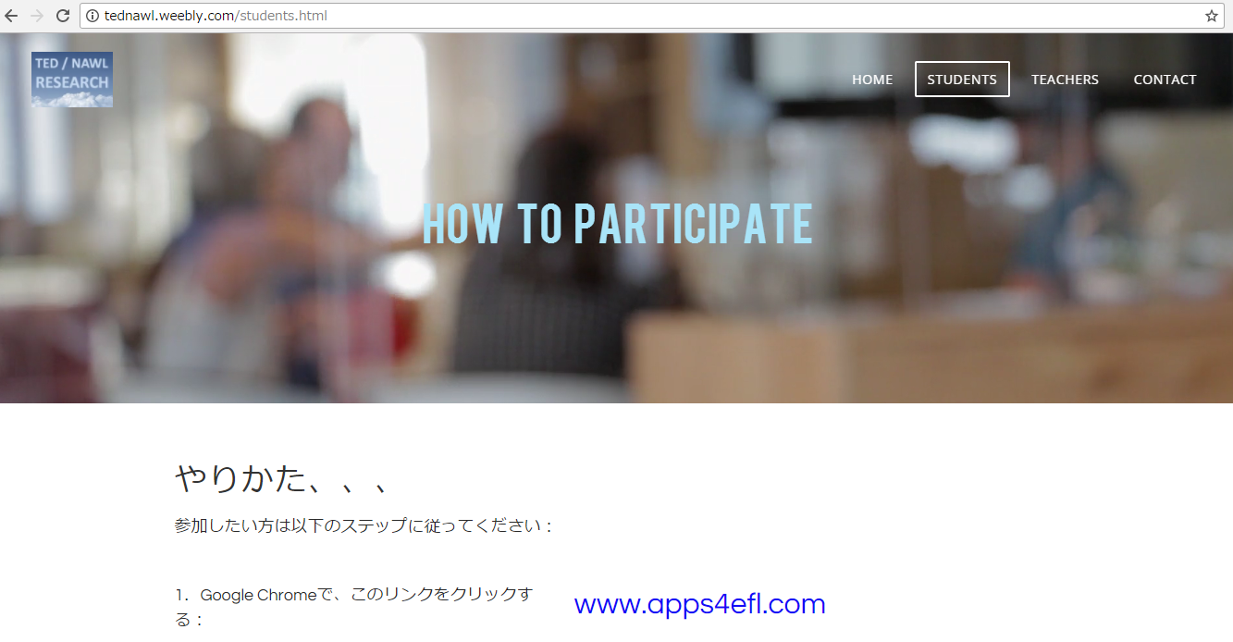
Notes:
PAUL

Slide 19
Notes:
PAUL

Slide 20
Background
Research Questions
Method
Results
Questions?
Notes:
xx

Slide 21
Background
Research Questions
Method
Results
Questions?
Notes:
xx

Slide 22
Control versus…
X
KWIC
L2 Definition
Image
X
O
Notes:
Only Image versus Control was significantly different

Slide 23
Image App
+ 0.65 words
+ 3.25%
Notes:
The pre- and Post-tests used L2-L1 translation
Maybe images, being non-linguistic – can bridge gap between L1 and L2
Whereas L2-only apps cannot

Slide 24
Background
Research Questions
Method
Results
Questions?
Notes:
xx

Slide 25
Background
Research Questions
Method
Results
Questions?

Slide 26
Thanks for Listening!
https://goo.gl/iBDCSg

